Slide 1
HSBC SmartSandbox Proposal
Developer Portal + SmartMock Evolution Beyond DAC Open Banking Sandbox

Slide 2
Executive Message: Why Now
• HSBC already owns the key capabilities: Developer Portal, HKMA P3 APIs, Open Banking experience.
• SmartMock provides the simulation execution engine.
• The strategic opportunity is evolving API sandboxing into business integration simulation.

Slide 3
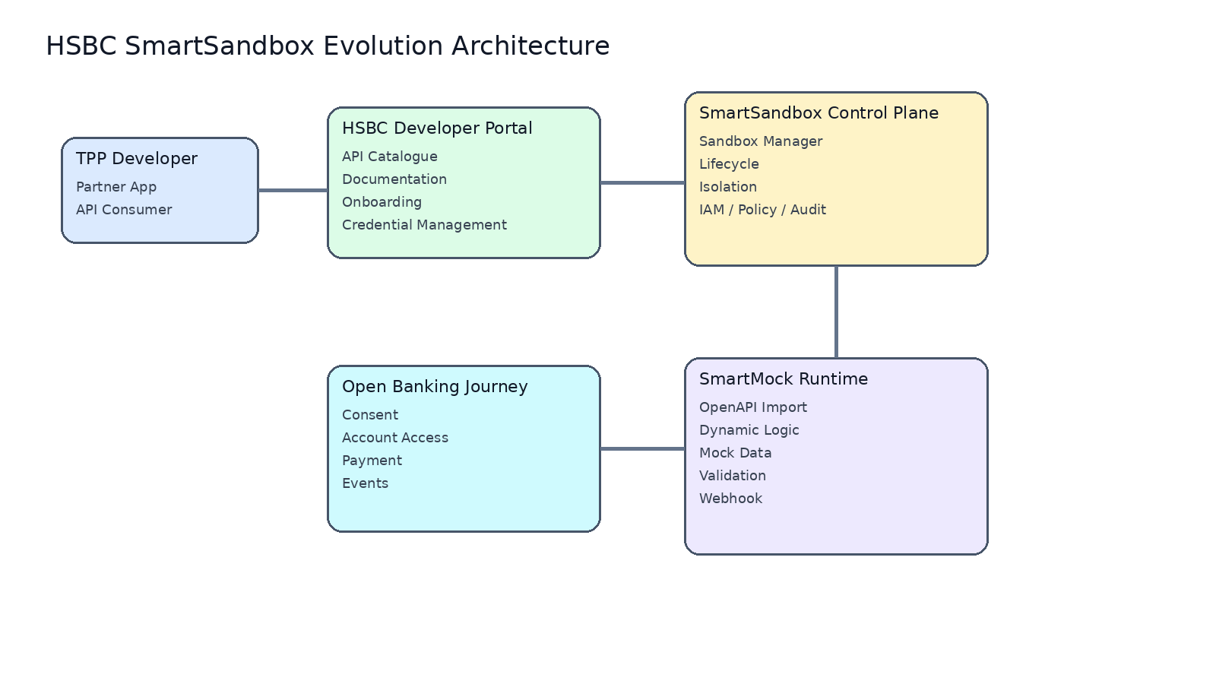
Target Architecture: SmartMock → SmartSandbox

Slide 4
DAC vs HSBC SmartSandbox: Strategic Positioning
• DAC provides a mature Open Banking sandbox capability.
• HSBC differentiates through existing portal ownership and SmartMock extensibility.
• The comparison is not mock server versus sandbox; it is API testing versus integration simulation.

Slide 5
Major Capability Comparison
Capability | DAC / DigitalAPI | HSBC SmartSandbox
Developer Portal | Vendor capability | Already built HSBC portal
HKMA P3 APIs | Supported | Already onboarded
PSD2 Capability | Supported | Proven experience
Consent Journey | Standard flow | End-to-end simulation
Dynamic Data | Configured data | Business state simulation
Custom Behaviour | Limited | SmartMock logic
Roadmap Ownership | Vendor | HSBC strategic capability

Slide 6
Open Banking Journey Advantage
• SmartSandbox validates complete business journeys:
• 1. Consent creation
• 2. Customer authorisation
• 3. Account access
• 4. Payment initiation
• 5. Payment status
• 6. Webhook notification

Slide 7
Dynamic Data Simulation
• Move from static API responses to realistic business states.
• Simulate customer, account, transaction, consent and payment lifecycle.
• Enable partners to test real integration scenarios before production.

Slide 8
Long-Term Roadmap
• Phase 0: SmartMock enterprise hardening.
• Phase 1: SmartSandbox lifecycle, isolation and scenario platform.
• Phase 2: External API virtualization and advanced journeys.
• Phase 3: AI-assisted intelligent sandbox.

Slide 9
Strategic Recommendation
• Do not position SmartSandbox as another API mock solution.
• Position it as HSBC-owned Open Banking Integration Simulation Platform.
• SmartMock remains the engine; SmartSandbox becomes the strategic platform.

